Slide 1
Advanced Topics of Multi-Armed Bandits
By Stephen Gou
Nov 2018

Slide 2
Topics
UCB v.s Thompson Sampling
Bandits Under Non-Stationary Environment
Offline Evaluation of Bandit Algorithms
Gaussian Process in Bandits

Slide 3
UCB – Upper Confidence Bound
Optimism in the face of uncertainty
Constructs an optimistic guess for each action
Picks action with highest optimistic guess

Slide 4



UCB
Chernoff-Hoeffding inequality
How to pick the bound?
Notes:
Chernoff H inequality for sumed average of iid vars, and this equation is special case for Bernouli

Slide 5
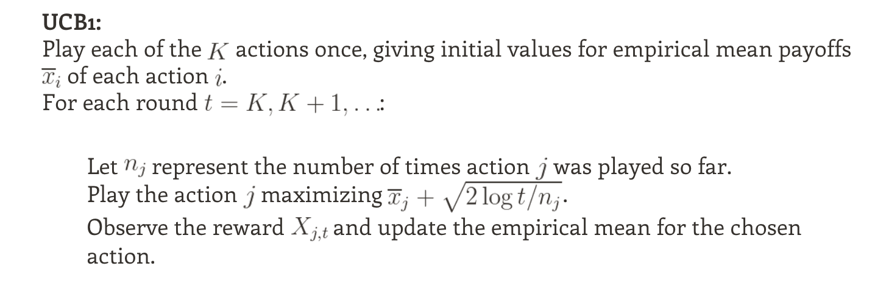
UCB Algorithm
Source: [7]

Slide 6
UCB – Pros and Cons
Pros:
Strong theoretical guarantee – upper bound scales with log of T
Do not need to sample posterior
Cons:
Cannot do batch update. Why?
Cannot incorporate prior knowledge
Notes:
Not stochastic, pick argmax, so if no update would always do same action

Slide 7
UCB – Questions?

Slide 8
Bandits under Non-Stationary Environment
Definition:
MAB assumes a distribution of contexts, actions and rewards.
Non-stationary environment if this distribution change over time

Slide 9
Bandits under Non-Stationary Environment
Switching Bandit (piece-wise stationary):
abrupt changes at some time steps
Adversarial Bandit:
Reward chosen by an adversary
Model any form of non-stationary environment

Slide 10
Why is this a problem?
In many real world situations, underlying distribution are not static
Factors can change suddenly and dramatically
Examples:
a user's interest in watching NBA videos would suddenly drop in June when the season is over.
a user’s interest in restaurants in the neighborhood change if moved to another city.
Any other situation?

Slide 11
Switching Bandit Simulation
Simulation Setup:
Agent: LinUCB
Randomly initialize true regression weights.
Compare cumulative regrets in two cases:
1) True weights stay the same through simulation.
2) Abrupt change of distribubtion at one time step.
Link to notebook

Slide 12
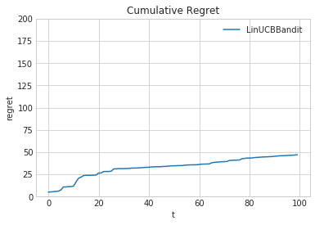
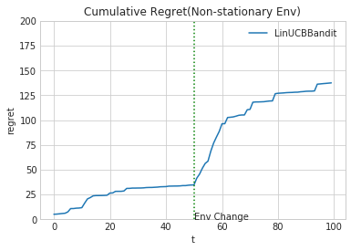
Cumulative Regret Comparison
Notes:
2 problems: 1)cumulated large regrets during re-converging. 2) re converge takes much longer time due to strong established belief

Slide 13
Solutions for Non-Stationary Environment
Memory loss:
Discounted UCB
Sliding Window UCB/TS
Change detector
Hierarchical bandits (slaved bandits)

Slide 14
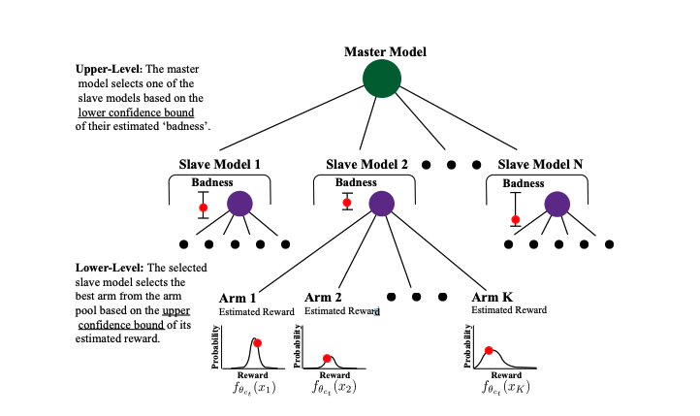
Hierarchical bandits (slaved bandits)
Source:[1]

Slide 15
Non-Stationary Environment – Questions?

Slide 16
Offline Evaluation of Bandits
Definition:
Evaluate bandit algorithms on data-sets/logged data instead of live interaction
Why offline?
Protect user experience
Reduce cost
No replicable results from online
Simulation introduces bias

Slide 17
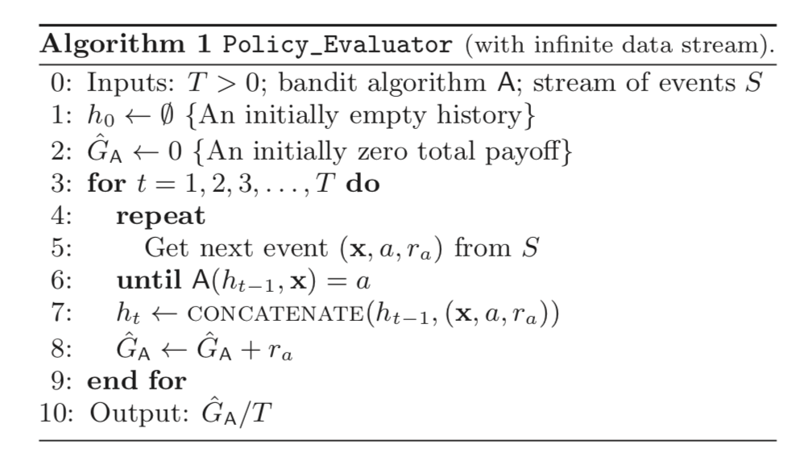
Evaluation Methods
Source: [5]

Slide 18
Performance and Limitations
Performance:
Unbiased estimation if logged by uniform policy
Bounded error that decreases with T by a fixed policy
Limitations:
Throw away large amounts of data (K-1)/K
Uniform logging policy unrealistic usually

Slide 19
Offline Evaluation – Questions?

Slide 20
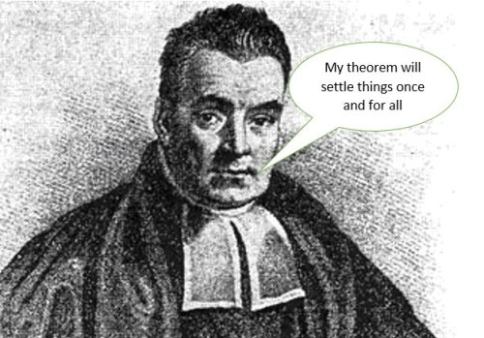
Gaussian Process in Bandits
What is GP?
GP is a distribution over functions
Linear Regression Bayesian Linear Regression Gaussian Processes
0%
Scale of Bayesianness
100%
Source: google images
Notes:
GP is stochastic process over a set of random variables such that every possible linear combinations of these vars are normally distributed

Slide 21
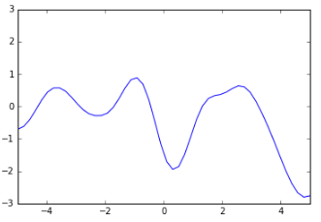
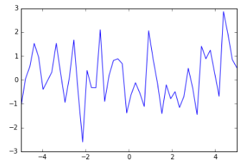
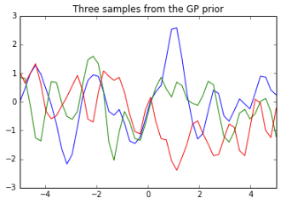
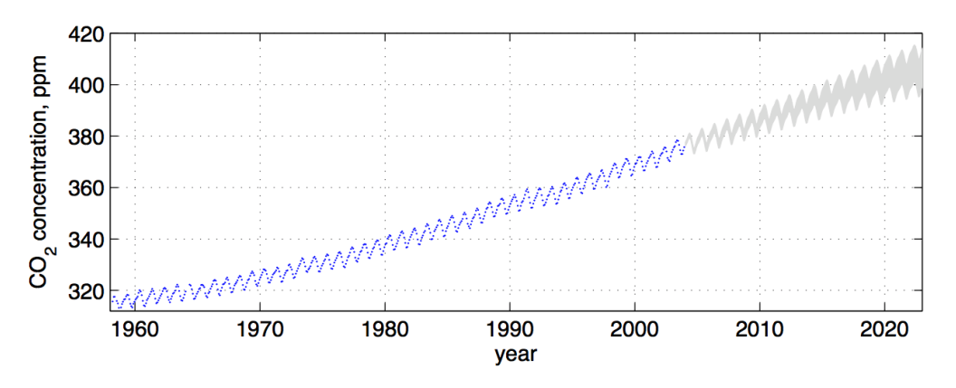
GP - Intuition
What is a distribution over functions
Prior
Characteristics of functions: Smoothness, periodicity, trend and so on
Source: [10], [11]

Slide 22

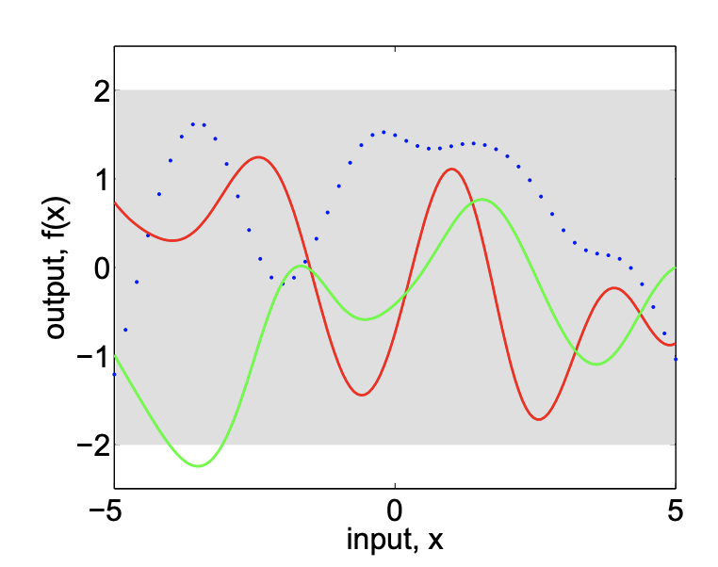
Formal Definition of GP
GP defines a normal distribution over any subsets of a collection of random variables
Prior is k(x,x’): covariance function that gives the covariance between any 2 points
Has to satisfy positive semi-definiteness
Often referred to as “kernel”
Source: [2]
Notes:
Guaranteed to work with continuous space automatically by: Kolmogorov extension theorem

Slide 23
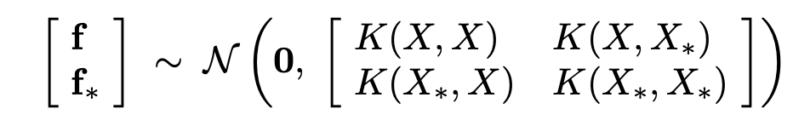
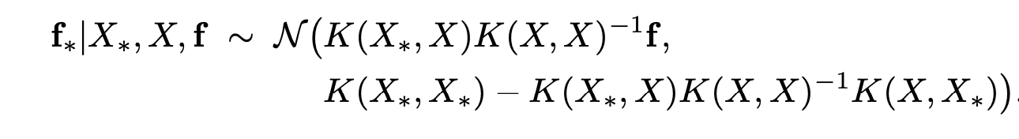
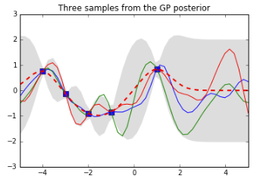
GP - Predictions Given Observations
Joint distribution with observed data points (Non-Noise Case):
Posterior distribution = Conditional distribution given observed data points:
Source: [10]

Slide 24
GP – Pros and Cons
Pros:
No need to think about features, can be infinite
Priors directly over function characteristics
Model continuous action
Easier to tune hyper-parameters than lets say NN
Cons:
Non-parametric
Extremely expensive O(N^3), there’s approximation technique
Not explainable
Notes:
Can compute likelihood straightforwardly, so clear to find good hyper params

Slide 25
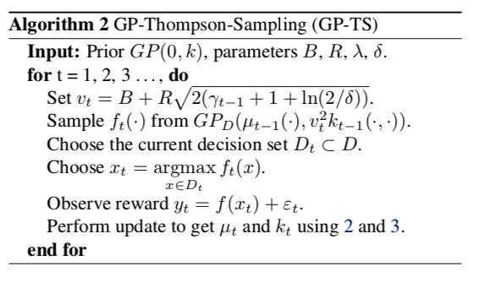
GP-Thompson Sampling
Source: [6]
Notes:
Vt hypter parameters, time varying to tunr exploration tradeoff

Slide 26
Thank you! Questions?

Slide 27
References
[1]Wu, Qingyun et al. “Learning Contextual Bandits in a Non-stationary Environment.” SIGIR (2018).
[2] Rasmussen, Carl E.. “Gaussian Processes for Machine Learning.” Advanced Lectures on Machine Learning (2009).
[3] Li, Lihong et al. “A Contextual-Bandit Approach to Personalized News Article Recommendation.” WWW (2010).
[4] Allesiardo, Robin et al. “The non-stationary stochastic multi-armed bandit problem.” International Journal of Data Science and Analytics 3 (2017): 267-283.
[5] Li, Lihong et al. “Unbiased offline evaluation of contextual-bandit-based news article recommendation algorithms.” WSDM (2011).
[6] Chowdhury, Sayak Ray and Aditya Gopalan. “On Kernelized Multi-armed Bandits.” ICML (2017).
Blogs/Online Sources:
[7] https://jeremykun.com/2013/10/28/optimism-in-the-face-of-uncertainty-the-ucb1-algorithm/
[8] https://lilianweng.github.io/lil-log/2018/01/23/the-multi-armed-bandit-problem-and-its-solutions.html#upper-confidence-bounds
[9] https://www.quora.com/Is-UCB1-the-best-multi-armed-bandit-algorithm-for-optimizing-a-website
[10] http://katbailey.github.io/post/gaussian-processes-for-dummies/
[11] http://www.cs.toronto.edu/~rgrosse/courses/csc411_f18/slides/lec20-slides.pdf

